Slide 1
Central Nervous system
Key structure of the CNS

Slide 2
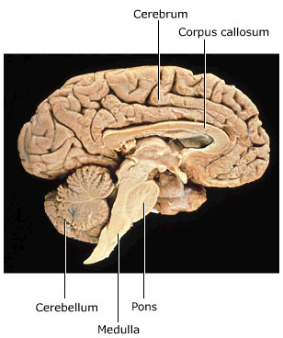
The brain
Cerebrum
Cerebellum
Hypothalamus
Medulla oblongata (part of the brain stem)

Slide 3
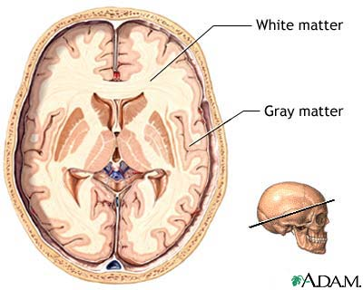
The cerebrum
Has a distinct organisation.
Outermost layer 2 – 4 mm of grey matter (called the cerebral cortex)
Middle layer: White matter
Inner most area: grey matter (called the basal ganglia)

Slide 4
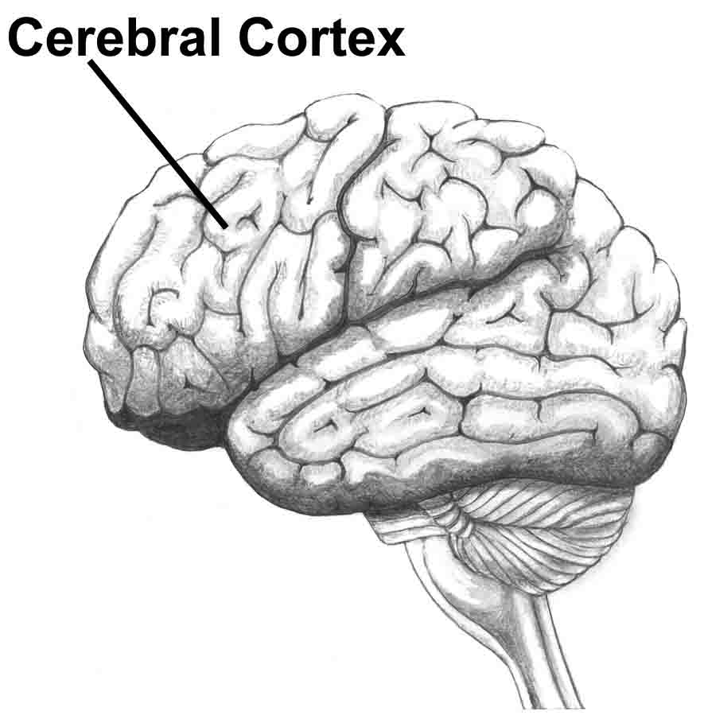
The cerebrum
The cerebral cortex is folded – increasing the surface area of the cortex.
Rounded ridges – called convolutions or gyri
Separated by down folds. Shallow folds are called sulci. Deep folds are called fissures.

Slide 5
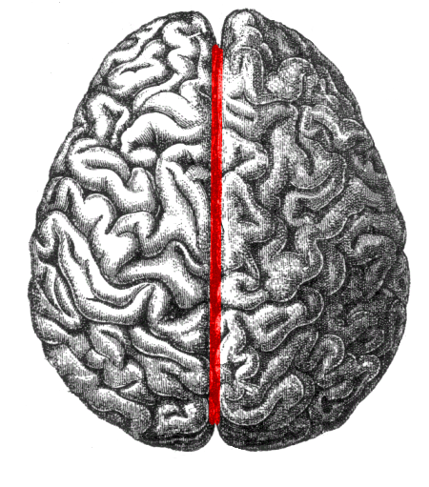
The cerebrum
The largest longitudinal fissure runs down the centre and divides the brain into the left and right hemispheres. At the base of the fissure a bundle of white matter connects the two halves.

Slide 6
The cerebrum
The folding pattern of the brain divides the brain into four distinct lobes:
Frontal
Temporal
Occipital
Parietal

Slide 7
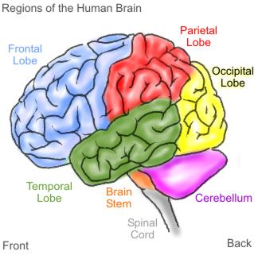

Slide 8
The cerebrum
Tracts – the name given to bundles of nerve fibres when found in the brain. Comprised of white matter. They:
Connect different parts of the cortex within the same hemisphere, between the left and right hemisphere and between the cortex and other parts of the CNS (spinal cord, cerebellum, hypothalamus)

Slide 9
The cerebrum
Functions:
Thinking
Reasoning
Learning
Memory
Intelligence
Sense of responsibility
Perception of senses
Initiation and control of voluntary muscle contraction.

Slide 10
Cerebrum
Scientist’s have investigated the functions of various parts of the cortex by
Studying brain waves
Stimulated particular areas and observed response
Examined changes in blood flow when a subject engages in certain mental or physical activity
Observed the effects on people who have suffered brain damage

Slide 11
Cerebrum
There are three types of functional areas:
Sensory areas: interpret impulses from receptors
Motor areas: control muscular movement
Association areas: intellectual and emotional processes and memory – memories are not stored in a nerve cell – they are pathways of nerve cells that is links between neurons.

Slide 12
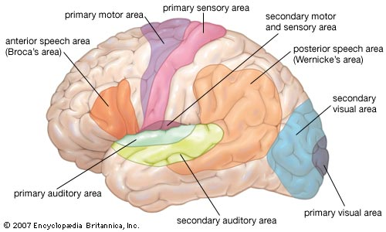

Slide 13
The cerebellum
Plays an important role in the function of the human body:
Controls posture and balance
Fine coordination of voluntary muscle movement
Takes place below the conscious level.
Keeps our movements smooth.
Takes information from stretch receptors in the muscles and the inner ear, processes this information and sends information back to the appropriate skeletal muscles.
Very important in learning new motor skills.

Slide 14
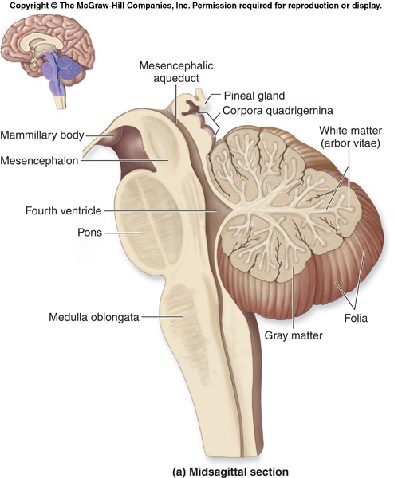

Slide 15
Hypothalamus
As we have seen coordinates the endocrine system by controlling the function of the pituitary gland
Also:
Regulates the autonomic nervous system (heart rate, blood pressure, parts of digestion)
Body temperature
Food and water intake
Patterns of waking and sleeping
contraction of the bladder
Emotional responses.

Slide 16
The medulla oblongata
About 3cm long, part of the brain stem which connects the brain to the spinal cord.
Contains:
The cardiac centre: regulates the rate and force of heart beat
The respiratory centre: regulate the rate and depth of breathing
The vasomotor centre: regulates the diamater of blood vessels.

Slide 17
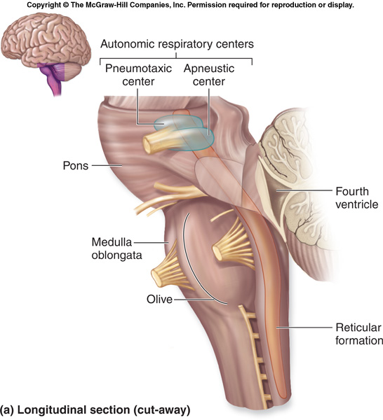

Slide 18
The medulla oblongata
Other functions that the medulla regulates which we will not look at specifically include:
Swallowing
Sneezing
Coughing
Vomiting
The hypothalamus and other higher areas of the brain play an important role in controlling the medulla.

Slide 19
The spinal cord
Roughly cylindrical structure that runs from the foramen magnum to the second lumbar vertebrae
Surrounded by a space containing fat , connective tissue and blood vessels which pad out the spinal cord and allow it to bend when the spine bends.

Slide 20
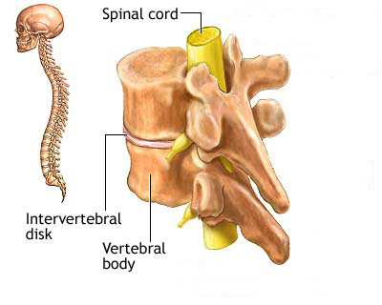
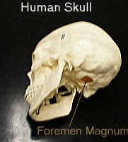
The spinal cord

Slide 21
The spinal cord
Made up of a grey matter shaped like a H surrounded by white matter.
In the middle is the central canal which runs the length of the spinal cord and contains CSF.

Slide 22
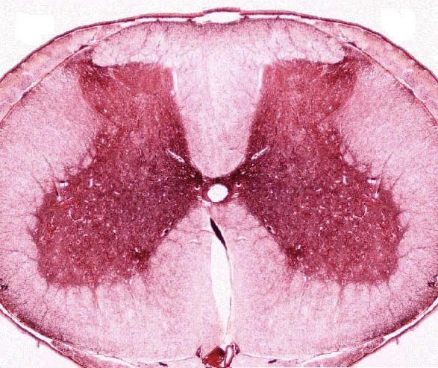
The spinal cord

Slide 23
The spinal cord
Ascending tracts – bundles of sensory axons that carry impulses toward the brain (upward)
Descending tracts – bundles of motor axons that carry impulses away from the brain to the muscles (downward)
Spinal reflexes – allow for fast automatic responses or reflexes by nerve cells in the spinal cord without input from the brain

